Slide 1
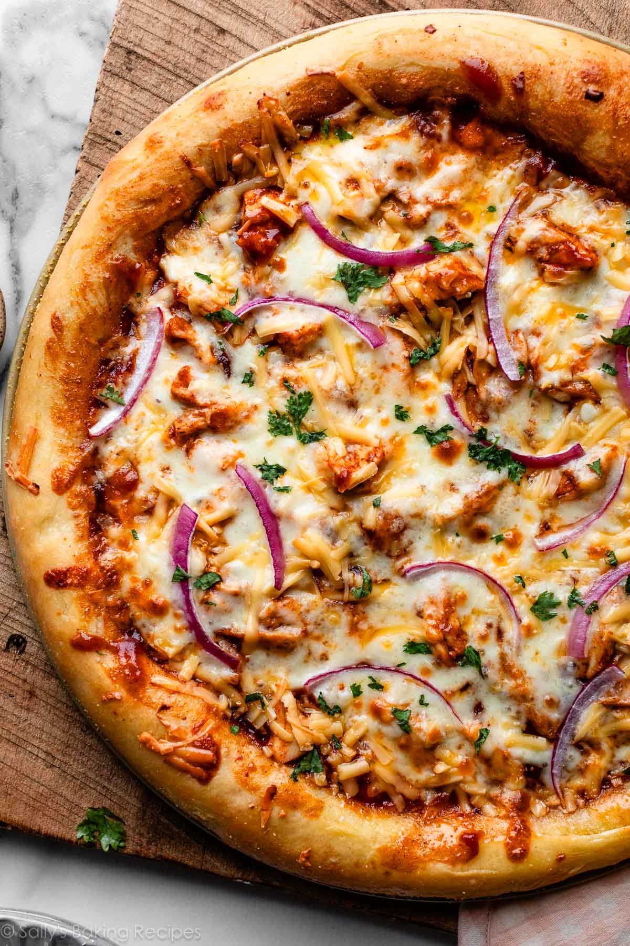
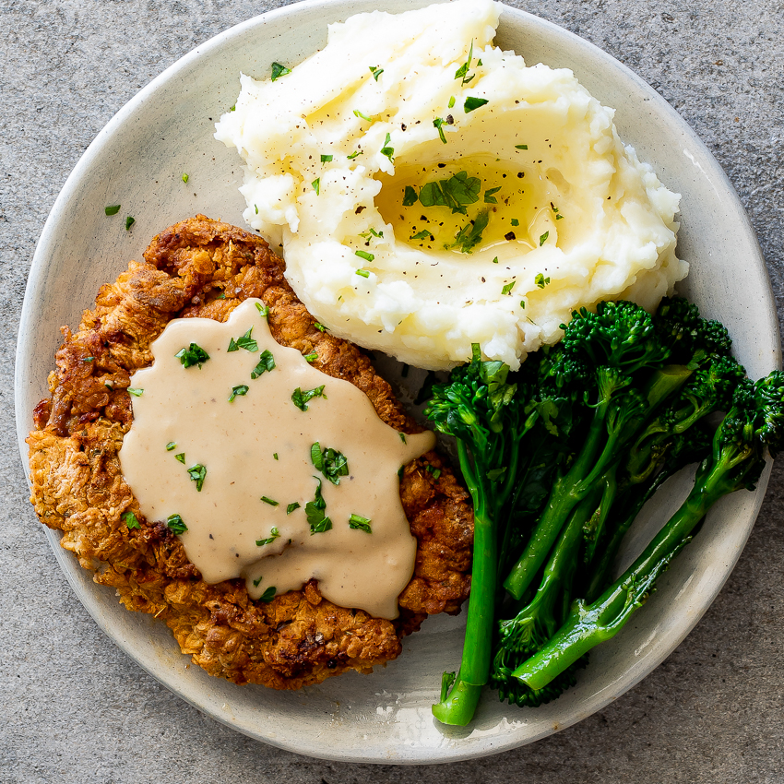
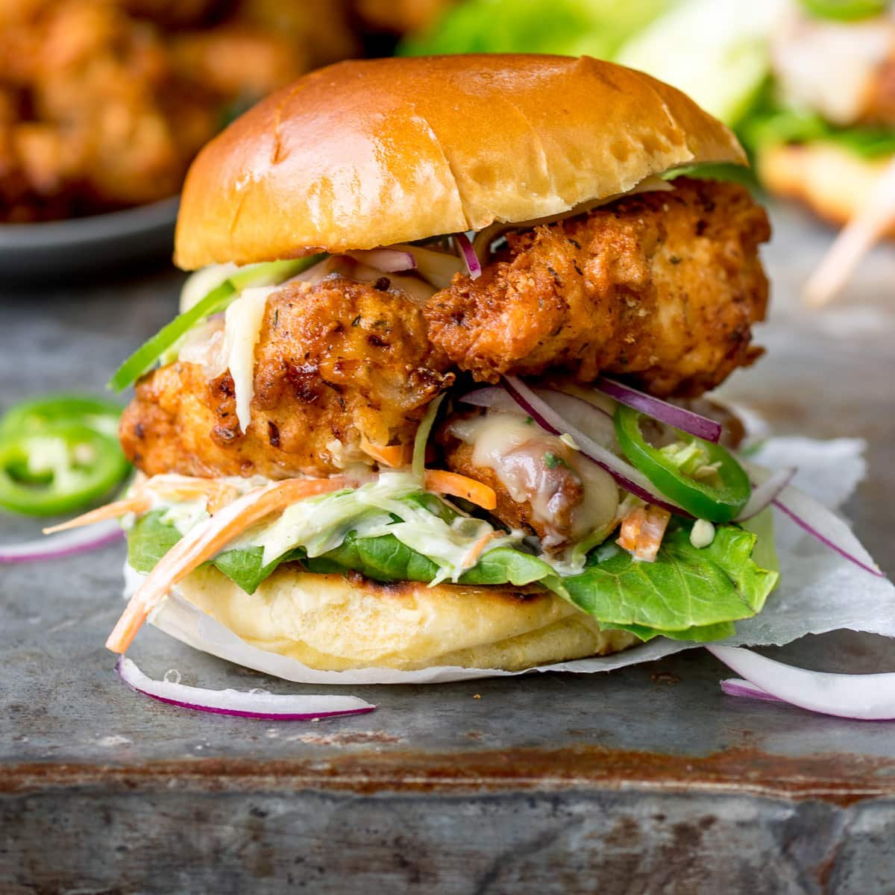
WELCOME TO BAM CAFE’S GUIDE

Slide 2
PROJECT OBJECTIVES
1. Order Management System
Objective: Allow customers to view the menu and place their orders.
Details: The customer can browse the menu, select multiple items, and place an order. The total cost of the order will be calculated and saved to a file, ensuring an efficient record-keeping system.
2. Customer Information Collection
Objective: Collect and validate customer information to ensure accurate order details.
Details: The system will request customer information such as name, email, phone number, and address, ensuring that the data entered is valid before accepting it.

Slide 3
3. Order Saving
Objective: Save customer orders to a text file for future reference.
Details: After the order is placed, the details will be saved to a file (including ordered items, prices, and customer information) for record-keeping and future reference.
4. File Management
Objective: Manage orders and customer data by saving them in text files.
Details: The order information, including customer details, is appended to a text file for each new order. This helps in maintaining a record of all transactions for tracking and billing purposes.
5. User-Friendly Interface
Objective: Provide an easy-to-navigate user interface for both ordering and game features.
Details: The user interface is designed to guide customers through the ordering process, prompt for necessary details, and offer them entertainment options through simple menu selections.

Slide 4
6. Data Validation and Error Handling
Objective: Ensure data entered by customers is valid.
Details: The system will validate user inputs for:
Name (only alphabets and spaces allowed)
Email (only Gmail addresses allowed)
Phone (only digits allowed)
Address (must not be empty)
7. Entertainment During Wait Time
Objective: Offer a way for customers to engage while waiting for their order to be prepared.
Details: While waiting, customers can play games like the riddles game or the Guess the Teacher game, ensuring that the waiting time is filled with fun activities.

Slide 5
IMPLEMENTATION DETAILS
1. Menu Display
Objective: Display the available food items and their prices to the customer.
Implementation: The system shows a list of menu items (name and price).Each item is represented by a structure that includes its name and price.
2. Order Placement
Objective: Allow the customer to select items from the menu and place an order.
Implementation: Customers choose menu items by entering their corresponding number. The selected items are stored in an order list, and the total price is calculated. The order details (items and total) are saved to a file for future reference.

Slide 6
3. Customer Information Collection
Objective: Collect necessary information from the customer (name, email, phone, and address).
Implementation: The system prompts the customer for their details and validates each field. Validation ensures that: Name contains only alphabets and spaces.Email contains @gmail.com. Phone contains only digits. Address is not empty.
4. File Handling
Objective: Save both customer orders and their personal information for record-keeping.
Implementation: Order details (items, price, and total) and customer information (name, email, phone, and address) are saved to a text file.
The file is updated in append mode to add new orders and customer details without overwriting existing data.

Slide 7
5. Game Features (Riddles and Guess the Teacher)
Objective: Provide entertainment options (games) for customers while they wait for their order. Riddles GameCustomers are presented with random riddles from a pre-loaded list. They attempt to answer, and the system checks if their response is correct. The game continues until the customer decides to quit. Guess the Teacher GameRandom hints about teachers are displayed, and customers have to guess the correct answer. The game continues with new hints until the customer decides to stop.
6. Order Summary and Receipt
Objective: Show the customer a summary of their order and the total amount.
Implementation: After placing an order, a detailed summary (items ordered and total price) is displayed. The summary is saved to a file along with customer details for reference.

Slide 8
CHALLENGES & SOLUTIONS
Challenge 1: Managing Menu Items
Problem: How to efficiently store and retrieve menu items, including their names, prices, and descriptions?
Solution: Use a data structure like an array to store menu items. Each item can be represented as a struct or object containing the relevant information.
Challenge 2: Handling User Input
Problem: How to handle invalid user input, such as non-numeric characters when ordering?
Solution: Use exception handling mechanisms like if else statements and handle invalid input. Provide clear error messages to the user.

Slide 9
Challenge 3: Implementing Order Placement
Problem: How to implement the order placement feature, including calculating the total cost and displaying the order summary?
Solution: Use a loop to iterate through the selected menu items, calculate the total cost, and display the order summary.
Challenge 4: Storing and Retrieving User Information
Problem: How to store and retrieve user information, such as names, numbers, and addresses?
Solution: Use file handling mechanisms to store user information in a file. Implement functions to read and write user data.

Slide 10
Challenge 5: Implementing Game Features
Problem: How to implement the game features, including the Riddles Game and Guess the Teacher?
Solution: Design and implement the game logic using algorithms . Use random number generation to add randomness to the games.
Challenge 6: Handling Exceptions and Errors
Problem: How to handle exceptions and errors that may occur during the program's execution?
Solution: Use if else statements and handle exceptions. Provide clear error messages to the user and implement recovery mechanisms when possible.

Slide 11
KEY FEATURES
1. Interactive Menu Display
Users can view the full menu with items and prices, and place an order by selecting items from the list.
Benefit: Provides a user-friendly interface for customers to browse the menu and select items easily.
2. Order Management
Customers can select multiple items, with each item being added to their order list. The system calculates the total order price and stores the order information in a file (orders.txt).
Benefit: Efficient handling of orders, ensuring that the cafe maintains a record of all customer orders.

Slide 12
3. Customer Information Collection
Validates and stores essential customer details such as name, email, phone number, and address. Ensures customer data integrity and provides a smooth ordering experience.
Benefit: Captures crucial information for order delivery or future marketing.
4. Input Validation
Validates customer inputs (name, email, phone number, address) to ensure that only correct and meaningful data is saved. Invalid inputs are rejected, and the customer is prompted to re-enter the data.
Benefit: Reduces errors by ensuring proper data entry.
5. Entertainment Features (Games)
Includes a Riddles Game and a Guess the Teacher Game to engage customers while they wait for their orders. Both games provide random questions and answers, adding variety to the experience.
Benefit: Enhances customer experience and keeps them entertained during their visit.

Slide 13
6. Order and Customer Data Storage
Orders and customer information are stored in a text file (orders.txt), allowing the cafe to keep track of customer interactions and order history.
Benefit: Provides a record for business analysis, inventory management, or order delivery.
7. Randomized Game Questions
Randomly selects riddles and teacher hints from an external file to offer variety and unpredictability in the games.
Benefit: Keeps the games fresh and engaging for customers, encouraging them to play multiple rounds.

Slide 14
8. File Management
The system reads from and writes to text files to load data (riddles, teacher hints) and store orders.
Benefit: Ensures persistent storage without requiring complex database systems, making the solution lightweight.
9. Clear User Interface
The system uses simple console output to interact with users, displaying options, prompts, and feedback in a straightforward manner.
Benefit: Easy to use for customers without complex interactions.

Slide 15
OUTCOMES
1. Enhanced Customer Experience
Customers not only place their orders efficiently but also enjoy interactive games while waiting.
The system’s smooth operation and entertainment features increase customer satisfaction.
2. Operational Efficiency
The system simplifies the process of taking orders and validating customer information.
Reduces the possibility of manual errors in order-taking and customer data collection.

Slide 16
3. Data Management
The storage of orders and customer information in text files allows for easy record-keeping and traceability.
This data can be used to improve future orders or for marketing purposes (such as sending promotions).
4. Engagement and Retention
By offering games during the waiting period, the system encourages customer engagement and may increase the time customers spend at the cafe.
Increases retention by providing a fun experience that encourages customers to return.
5. Scalability
The system can easily be scaled to add more menu items, games, or customer features.
The use of simple file storage and basic C++ features makes it easy to extend and upgrade.

Slide 17
6. Error Reduction
Input validation ensures that only valid data is collected, reducing the risk of errors during order processing and customer data entry.
This leads to fewer mistakes and a more reliable service.
7. Data-driven Insights
Storing order and customer data can provide valuable insights into popular menu items, customer preferences, or peak order times.
This can inform business decisions related to menu updates, promotions, or staffing needs.
8. Cost-effective Solution
The use of basic text files for data storage and C++ for implementation makes the system cost-effective.
It doesn’t require complex hardware or software, making it a viable solution for small to medium-sized cafes.

Slide 18
